Slide 1
VOGUE TUSKER 3B SS OBSERVATIONS
PREPARED BY: V.DINESH
DATE:24/07/2024

Slide 2
PRODUCT FEATURES
PRODUCT NAME : VOGUE TUSKER 3B
MATERIAL OF THE BODY : STAINLESS STEEL
MATERIAL OF THE BURNER : BRASS FORGED BURNER
NO. OF BURNER : 3 (BIG,SMALL,MEDIUM)
PANSUPPORT : TUSKER ROUND 5MM PANSUPPORT
SHEET THICKNESS : TOP SHEET – 2MM ,FRONT SHEET – 0.6MM,REAR SHEET - 0.6MM.
BIG : 0.525 GASVALVE , 90 JET – 0.80MM
SMALL : 0.425 GASVALVE , 58 JET – 0.65MM
MEDIUM : 0.425 GASVALVE , 77 JET – 0.75MM
KNOB : PLASTIC KNOB

Slide 3
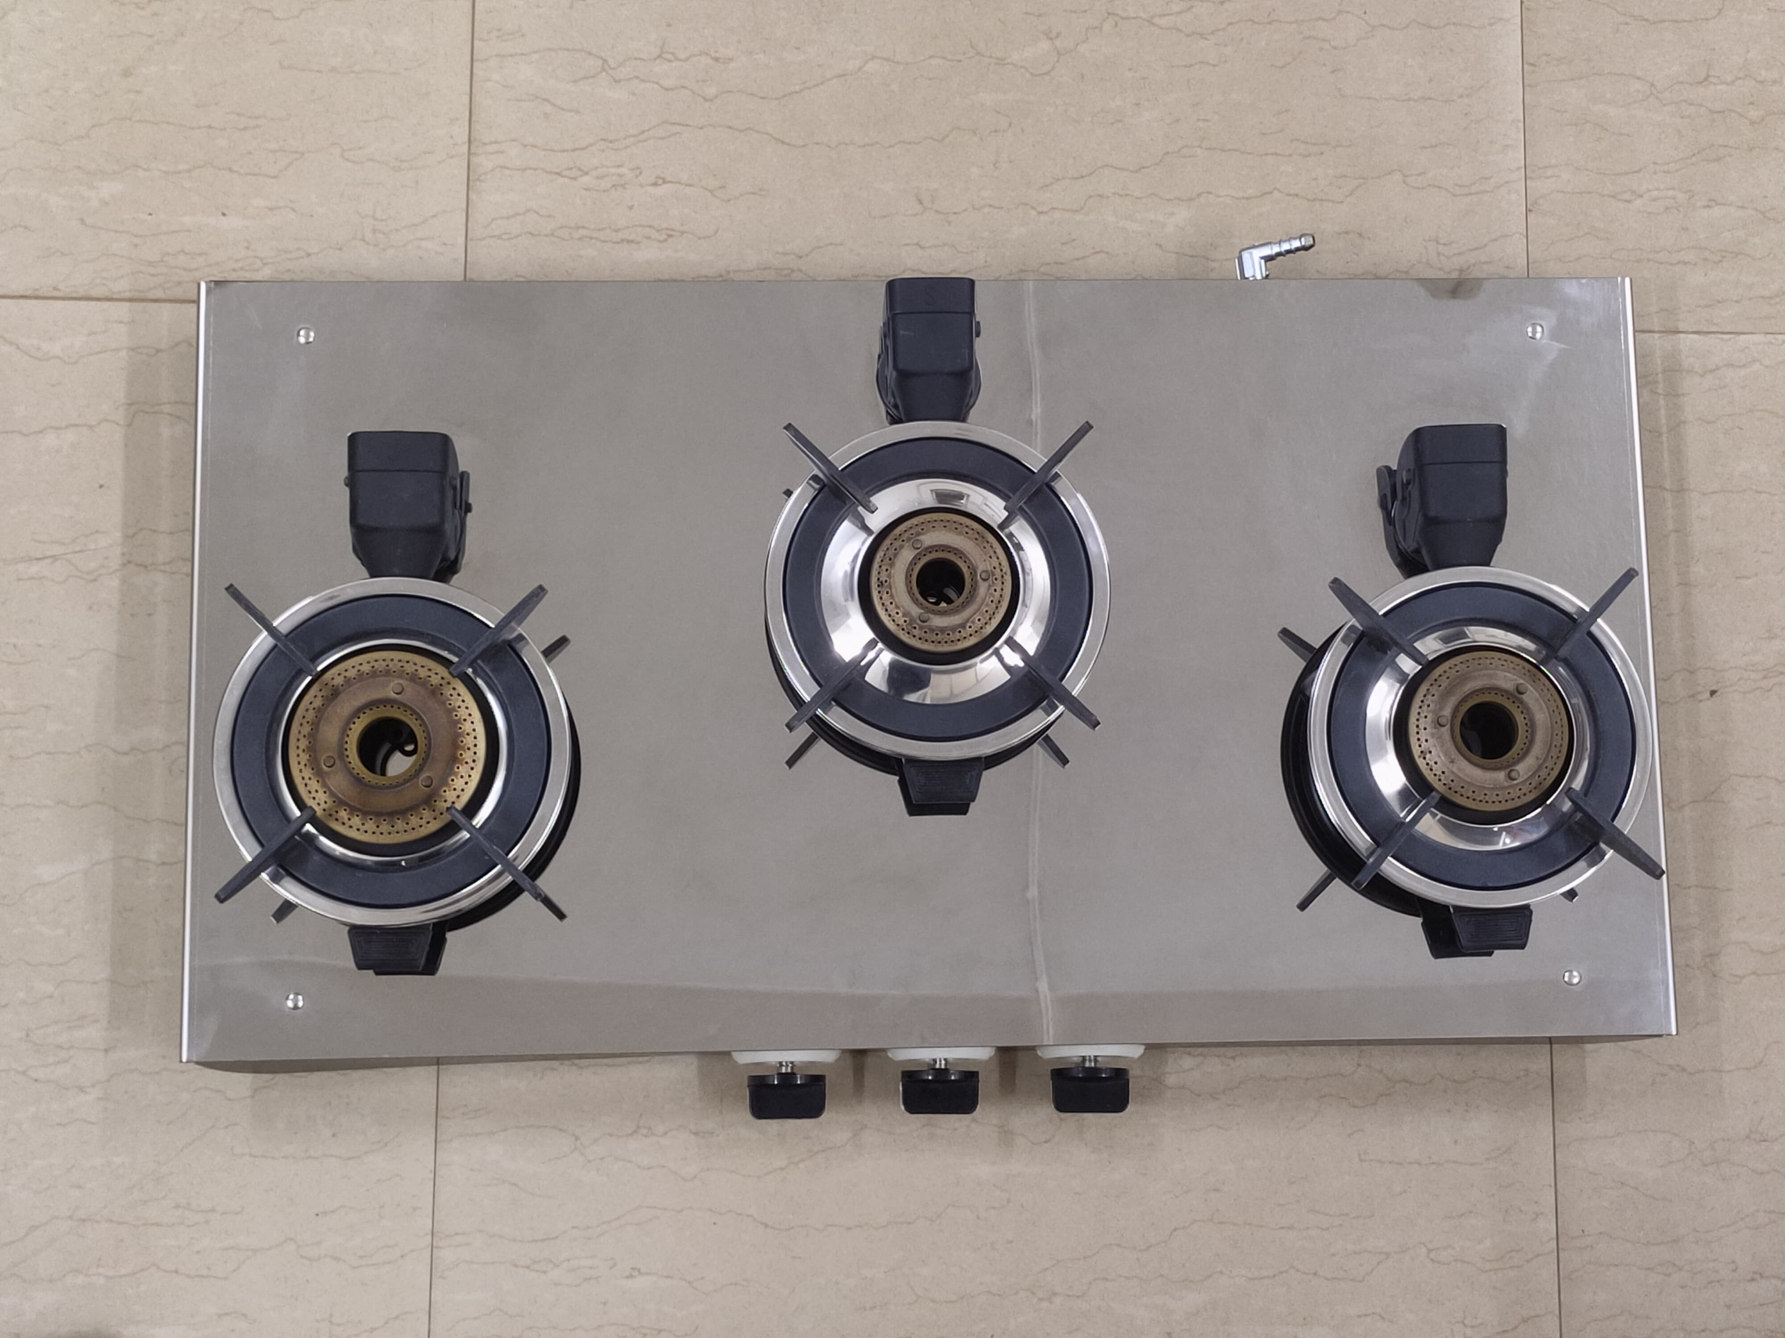
PRODUCT IMAGES
TOP VIEW
BOTTOM VIEW
REAR VIEW
FRONT VIEW
RIGHT VIEW
LEFT VIEW

Slide 4
SOOT FORMATION TEST
Result : After soot Formation Test ,No Yellow flame ,No Soot Formed on Vessel and Burner - OK

Slide 5
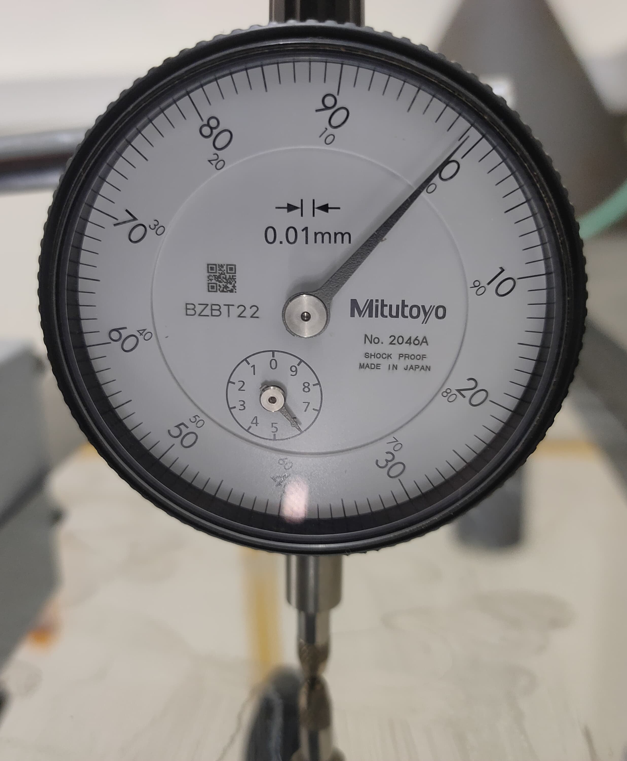
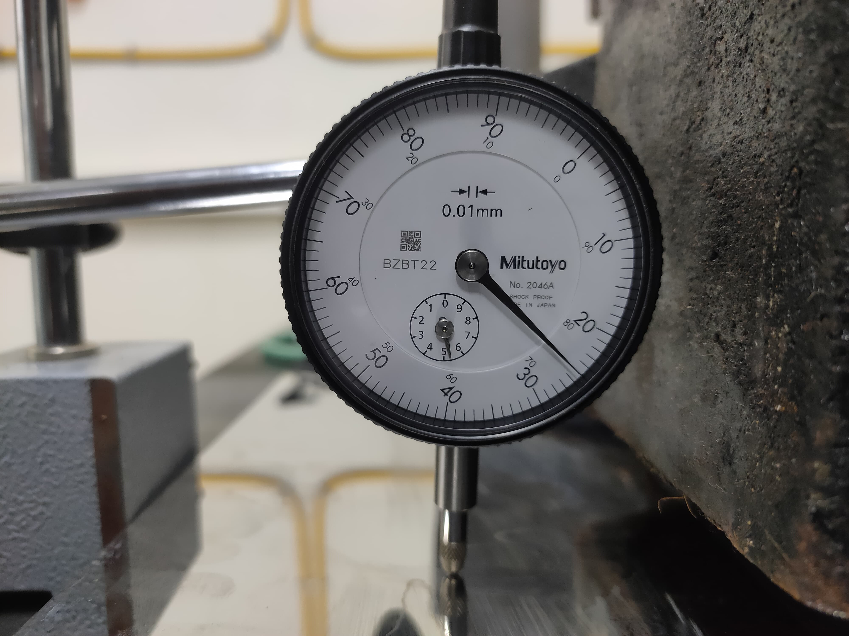
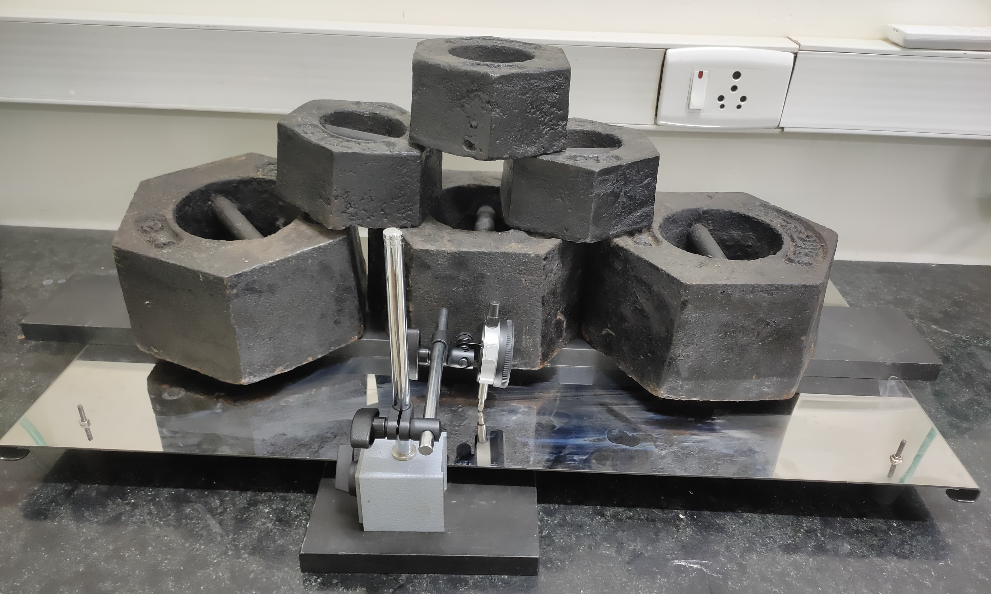
STRENGTH AND RIGIDITY TEST
Result : Vertical Deflection 0.75mm < 2mm – OK.
Length Wise 1mm < 5mm - OK
Width Wise 1mm < 5mm – OK
Note :But after applying load on the top sheet, light sag observed in the load area.

Slide 6
MEDIUM MIXING TUBE LEG UNEVEN FLATNESS & SHARP EDGES
Mixing Tube leg uneven Flatness and Top sheet sharp edges observed – NOT OK

Slide 7
MEDIUM MIXING TUBE LEG UNEVEN FLATNESS
Front area no Clearance from the ground level on the gas stove – NOT OK

Slide 8
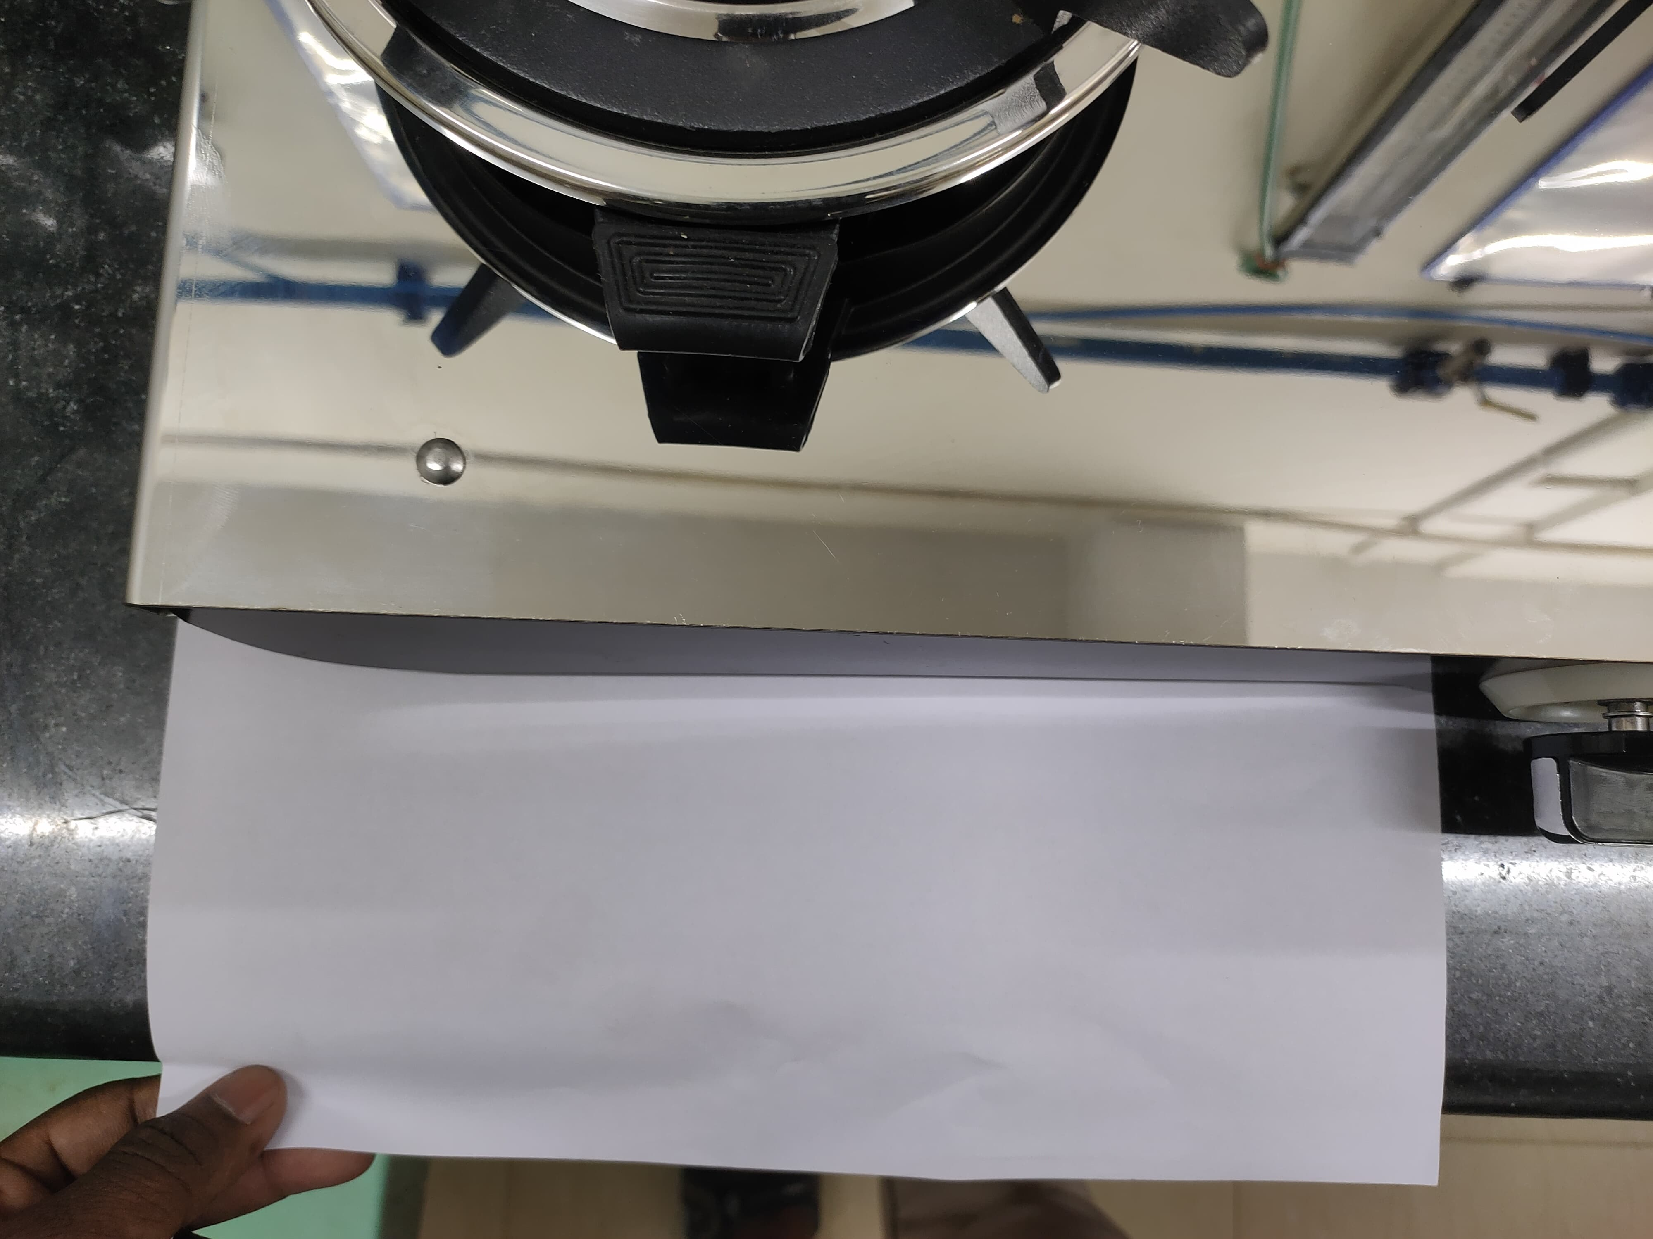
ASSEMBLY ISSUES
Front frame not in straight position – NOT OK
Revolving Nozzle not in straight position – NOT OK

